Slide 1

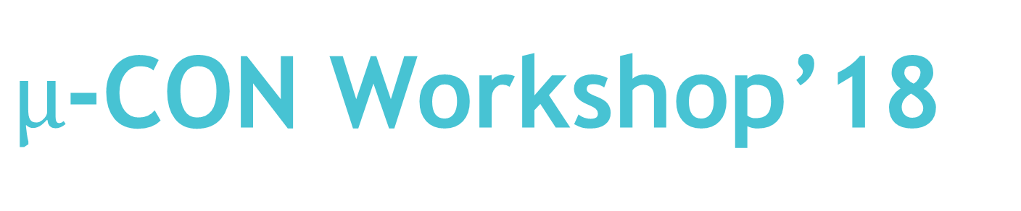
$µ$-CON Workshop’18
“ Wireless Game Controller
Using Infrared Data Transmission ”

Slide 2
Session 0: Basics of C Coding
26th Sep’18, 17:30 to 20:00 Hrs.

Slide 3
Basic Structure of a C program
Inclusion of header files
Declaration of main()
Declaration/Initialization of variables
Executable code
End of main()

Slide 4
BASICS OF C
Data types
Header files
Conditional statements
Looping statements

Slide 5
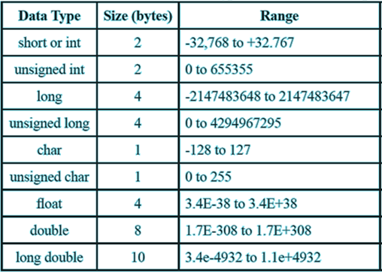
What are Data Types ?
A data type is a classification that specifies which type of value a variable has and what type of mathematical, relational or logical operations can be applied to it without causing an error.
Common data types include :

Slide 6
Header files – An Introduction
A header file is a file with extension .h which contains C function declarations and macro definitions to be shared between several source files.
Header files are a compilation of long sets of code with basic functions which can be included in one’s program, ensuring easy implementation of tasks.

Slide 7
Conditional Statements :
If
If-else
If-else if
Switch case

Slide 8
The “if” structure
#include<iostream.h> //header file
void main()
{
int a=10,b=7,c; //a,b,c are integer type variables
if(a>b) //here the condition is a>b
{ c=a+b; //executes the statement if the condition is true
}
}

Slide 9
The “if-else” structure
#include<iostream.h> void main() { int a=7,b=8;
if(a>b) //check if a is greater than b {
//execute a set of statements }
else { //execute a set of statements } }

Slide 10
The “ if-elseif ” structure
#include<iostream.h> void main() { int a=7; if(a==7) //check if it is equal to 7 {
//execute a set of statements }
else if(a!=7) //check if it is not equal to 7 { //execute a set of statements } }

Slide 11
Switch Case :
A switch statement allows a variable to be tested for equality against a list of values. Each value is called a case, and the variable being switched on is checked for each switch case.

Slide 12
Sample code snippet :
#include<iostream.h>
void main()
{
int a;
switch(a)
{
case '1' : //execute code break;
case '2' : //execute code break;
Default : //executes if no case matches
}
}

Slide 13
In the previous slide, what would happen if “break” was not used after each case?

Slide 14
Looping Statements :
for
while
do while

Slide 15
The three main points while writing any kind of loop include :
Initialization of loop variable
Checking the condition on the loop variable
Updation of loop variable

Slide 16
The “for” loop
In this, the program keeps incrementing the loop variable until the condition stays true and also runs a code you declare inside the for loop after the change each time.
Sample code :
//Assume headers and void main
//To print all the natural numbers till 100
for(int i=1; i<=100; i++)
{
printf(“%d”,i);
printf(“\n”);
}

Slide 17
The “while” loop
The while loop keeps executing the code (body of the loop) as long as the condition is true .
This sample code illustrates the working of while loop
//assume headers and void main
int s=1 ; while(s<101) {
//do some task s=s+1; }

Slide 18
The “do-while” loop
With working similar to while() , this looping structure ensures that the body of the loop is executed at least once.
This sample code illustrates the working of do while loop
//Assume headers and void main
int s=1 ; do {
//do some task s=s+1; }while(s<101);

Slide 19
A brief introduction to “Functions”
What is a function?
A function is a block of organized, reusable code that is used to perform a single, related action. Functions provide better modularity for one’s application and a high degree of code reusing.

Slide 20
Sample Code
//This program illustrates the use of functions
#include<iostream.h>
void sum()
{
int a=5,b=8,c;
c=a+b;
printf(“%d”,c);
}

Slide 21
void multiply()
{
int a=5,b=8,c;
c=a*b;
printf(“%d”,c);
}
void main()
{
sum();
multiply();
}

Slide 22
Thank You

